Slide 1

WEBD 5201 Web Development Framework
System Design and Infrastructure for Web Development

Slide 2

Web Development System Design
System design refers to designing the high-level architecture, structure, and components of a web application or system.
It involves making critical decisions about how the various parts of the application will work together to fulfill its requirements and objectives.

Slide 3
Components
Requirement Analysis
Architectural Design
Frontend Design
Backend Design
Database Design
Security Consideration
Scalability
Third-party service
Error handling
Deployment
Documentation
Testing Strategy and Maintenance

Slide 4
Requirement Analysis
Requirement analysis sets the foundation for successful software development by providing an unambiguous understanding of what needs to be built.
Functional Requirement - Functional requirements specify the desired behaviour of the system, such as user actions and system responses.
Non-Functional Requirement – Attributes of the system that include performance, scalability, security and reliability
Prioritization: Prioritize requirements based on their importance and criticality to the project's success. This helps in making informed decisions during the development process.

Slide 5
Architectural Design
Architectural design in software development refers to defining the high-level structure and organization of a software system or application.
System Components: Identifying the software system’s primary building blocks or components. These components could include modules, services, databases, user interfaces, and external integrations.
Component Interaction: Determining how these components interact with each other. This includes defining communication patterns, data flows, and interaction protocols.
Data Management: Deciding how data will be stored, accessed, and manipulated within the system. This involves choosing databases, defining data structures, and establishing data relationships.

Slide 6
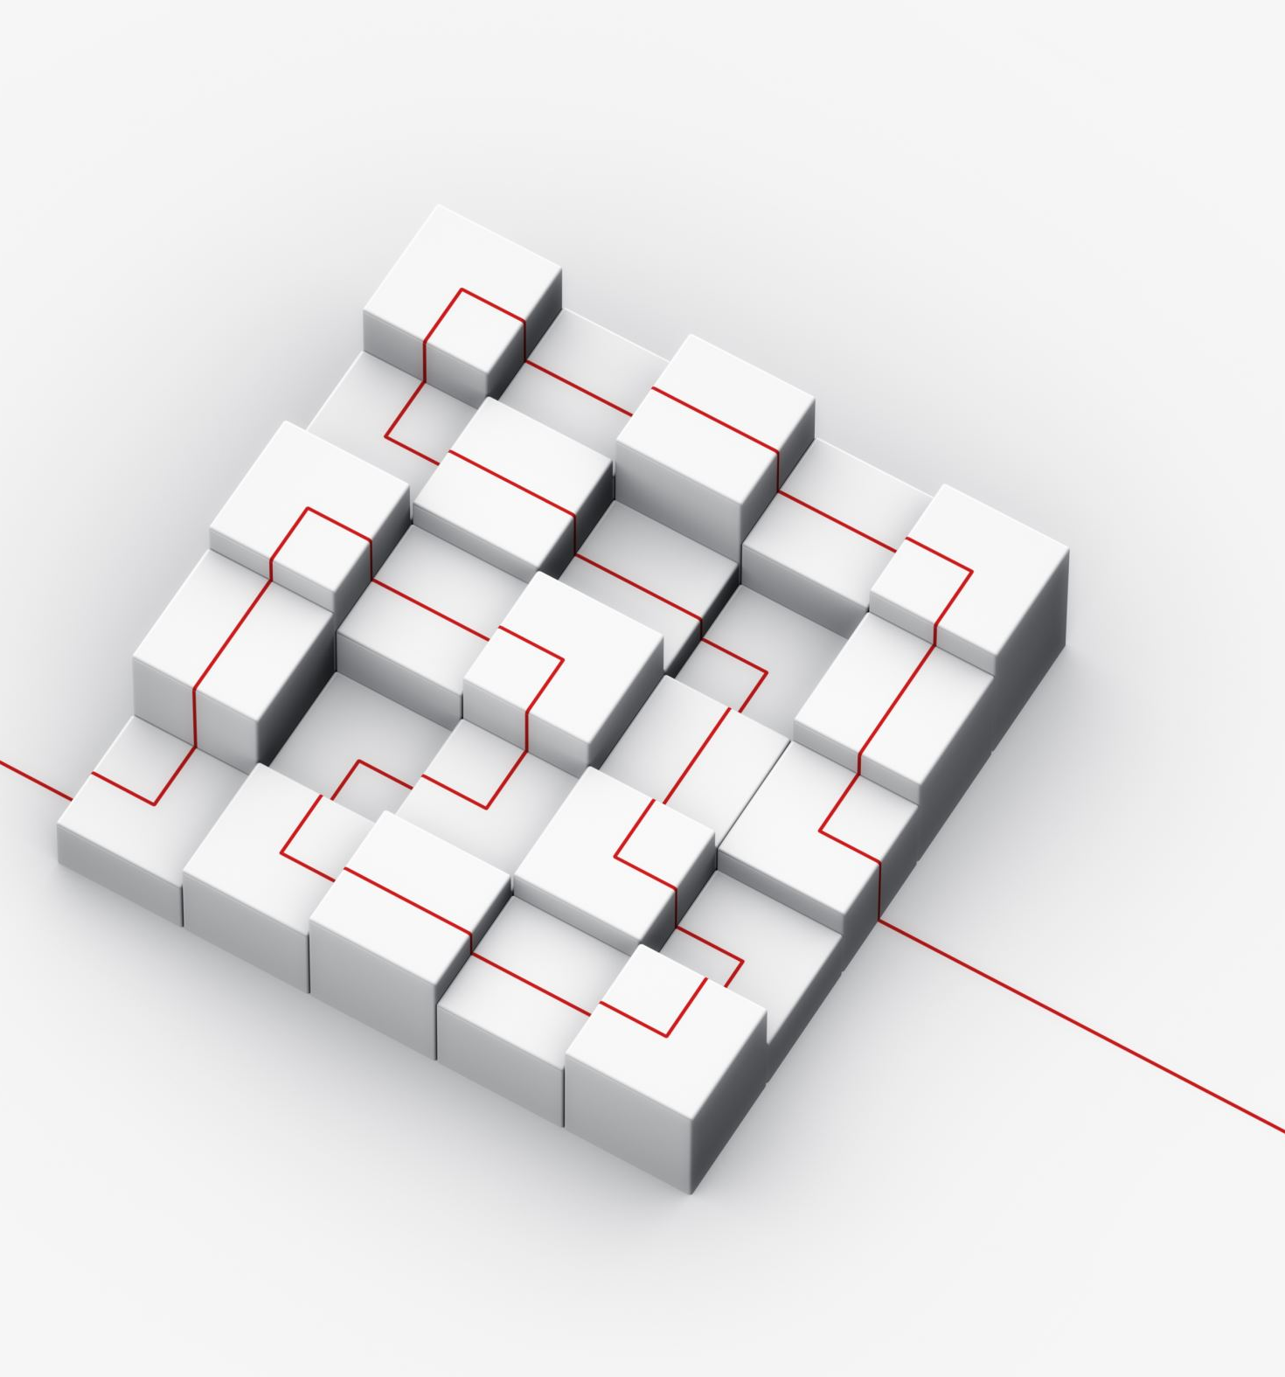
Frontend Design
Create wireframes and mock-ups to visualize the user interface.
Define the user experience (UX) and interface (UI) design.
Choose frontend technologies (HTML, CSS, JavaScript, and frontend frameworks like React, Angular, or Vue.js).

Slide 7
Backend Design
Plan for the server-side logic
Define the data models and database schema.
Select a backend programming language (e.g., Python, Node.js, Ruby, Java).
Determine the web framework (e.g., Express, Django, Ruby on Rails) for handling HTTP requests and responses.
Design APIs for client-server communication.

Slide 8

Database Design
Choose a suitable database system (e.g., MySQL, PostgreSQL, MongoDB) based on data storage and retrieval needs.
Create the database schema, define tables, relationships, and constraints.
Plan for data migration, backup, and scaling as needed.

Slide 9

Security Considerations
Implement security measures, including data encryption, authentication, and authorization.
Protect against common web vulnerabilities like SQL injection, cross-site scripting (XSS), and cross-site request forgery (CSRF).
Apply best practices for securing APIs and user data.

Slide 10
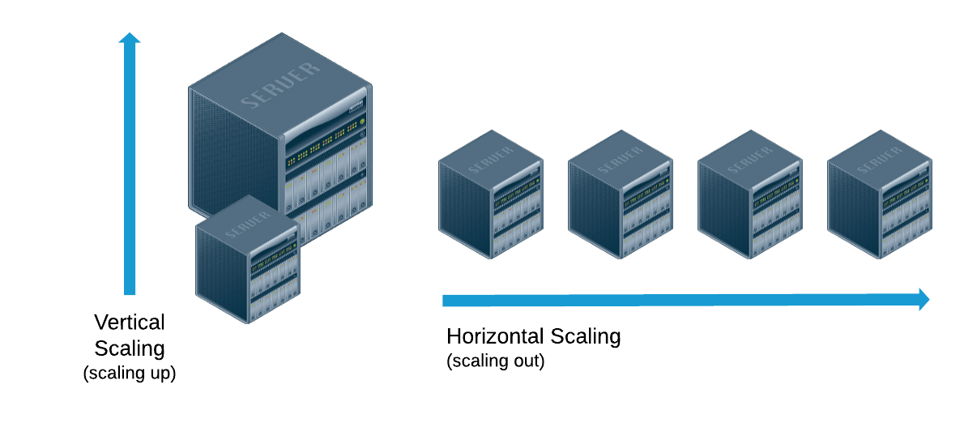
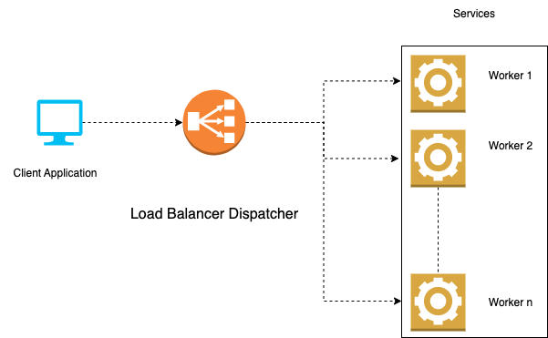
Scalability and Performance
Design for scalability by considering load balancing, caching, and database optimization.
Implement performance optimization techniques, such as content delivery networks (CDNs) and lazy loading.

Slide 11

Third-Party Services
Identify and integrate third-party services and APIs that enhance functionality (e.g., payment gateways, social media integration, maps).

Slide 12



Error Handling and Logging
Plan for error handling and logging to monitor application health and troubleshoot issues effectively.

Slide 13

Deployment
Choose a hosting environment (e.g., cloud platforms like AWS, Azure, or hosting providers like Heroku).
Set up deployment pipelines and continuous integration/continuous deployment (CI/CD) processes.
Automate deployment, scaling, and monitoring tasks.

Slide 14

Documentation
Document the system design, architecture, API endpoints, and usage instructions for other developers and stakeholders.

Slide 15

Testing Strategy
Develop testing plans and scripts for unit, integration, and end-to-end testing.
Implement testing frameworks and tools (e.g., Jest, Selenium).

Slide 16

Maintenance and Updates
Plan for ongoing maintenance, bug fixes, and feature updates.
Monitor and analyze application performance and user feedback for continuous improvement.

Slide 17

Activity 1
Load Balancer
Application Server vs Web Server
In a sudden traffic surge, how should the infrastructure scale to ensure the web application remains responsive and available to users? What measures should be in place to handle increased loads automatically without manual intervention?

Slide 18

Infrastructure
Setting up the infrastructure for web development involves creating the necessary environment and tools to develop, test, and deploy web applications or websites

Slide 19
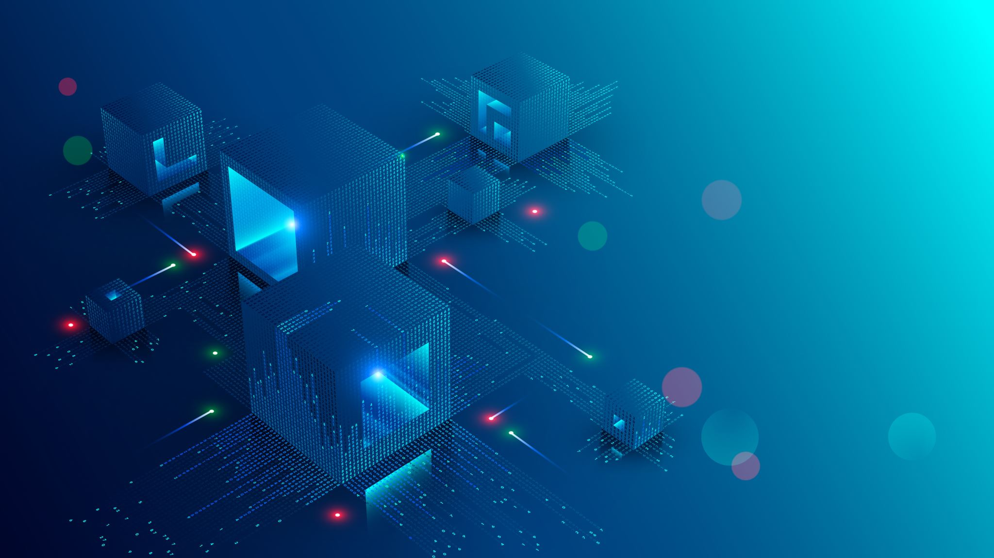
Hardware and Network Infrastructure
Choose the hardware and network infrastructure for your development team. This could include desktop or laptop computers, monitors, and a reliable internet connection.

Slide 20
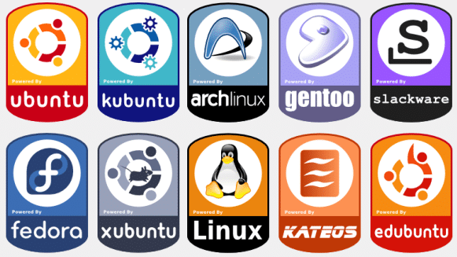
Operating System
Select an operating system for development. Popular choices include Windows, macOS, or Linux (Ubuntu, CentOS, etc.). The choice may depend on your team's preferences and the technologies you plan to use.

Slide 21
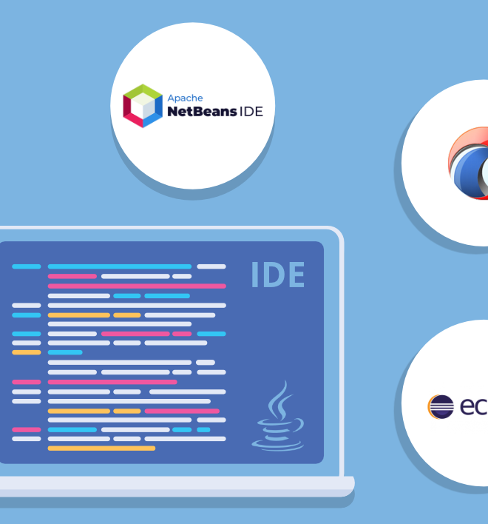
Integrated Development Environment (IDE)
Install an IDE or code editor suitable for web development. Some popular options include Visual Studio Code, Sublime Text, and JetBrains PhpStorm for PHP development.

Slide 22
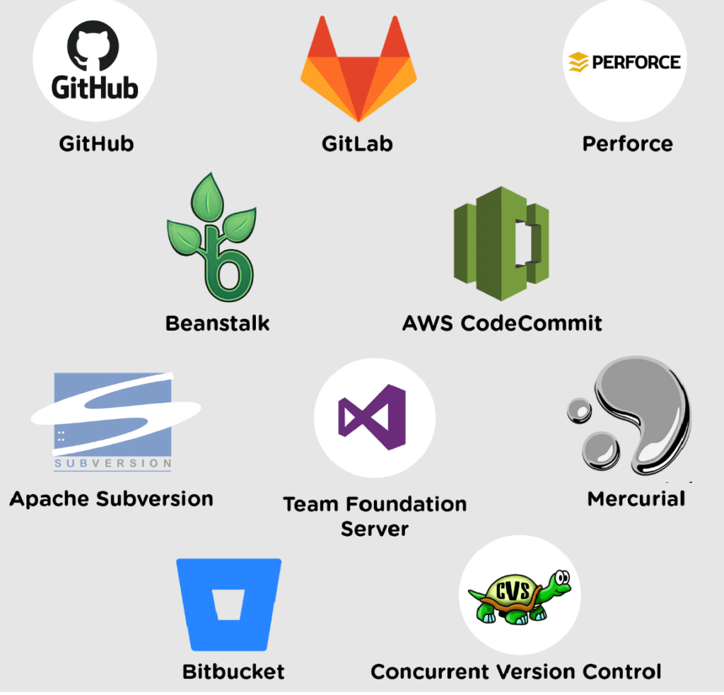
Version Control
Set up version control using Git and choose a platform like GitHub, GitLab, or Bitbucket for hosting your repositories. This enables collaborative development and code versioning.

Slide 23
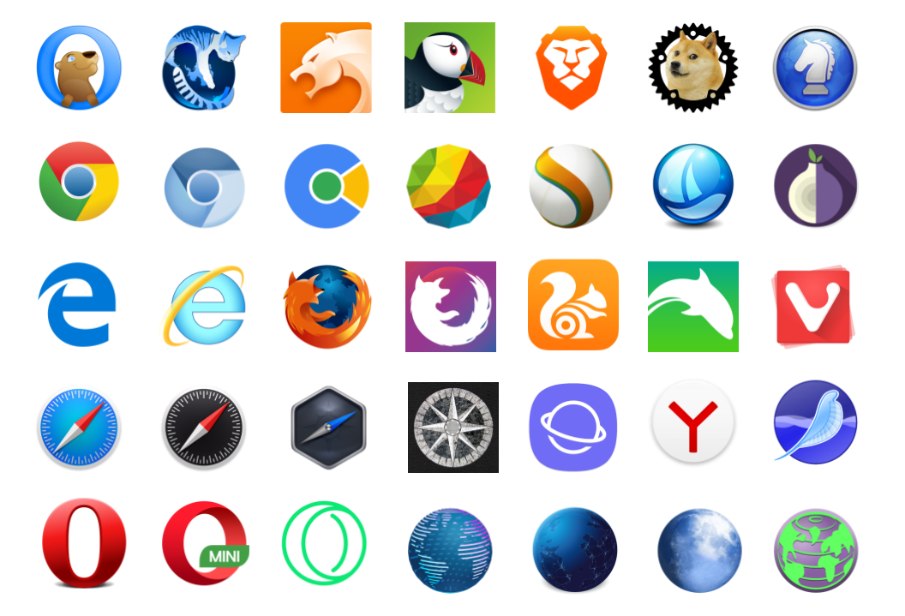
Web Browsers
Install various web browsers for testing purposes. Ensure compatibility with major browsers like Chrome, Firefox, Safari, and Edge.

Slide 24

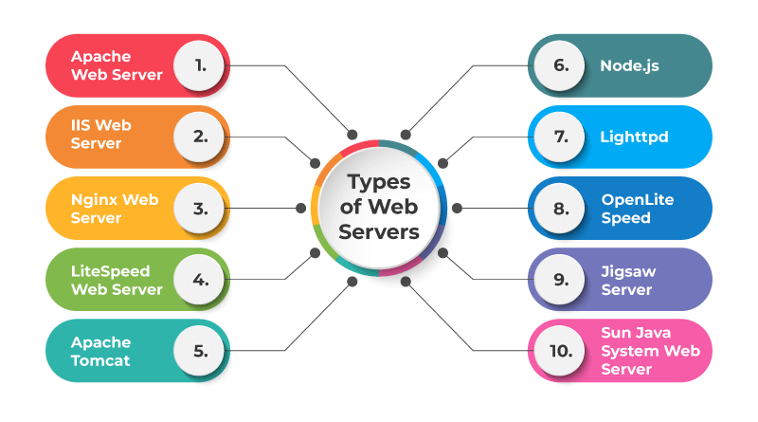
Server

Slide 25

Database Server
A database server is a specialized software application or hardware system that manages and stores structured data, allowing multiple users or applications to access, retrieve, update, and manipulate data in a database using a client-server model.
Common choices include MySQL, PostgreSQL, MongoDB, and SQLite.

Slide 26
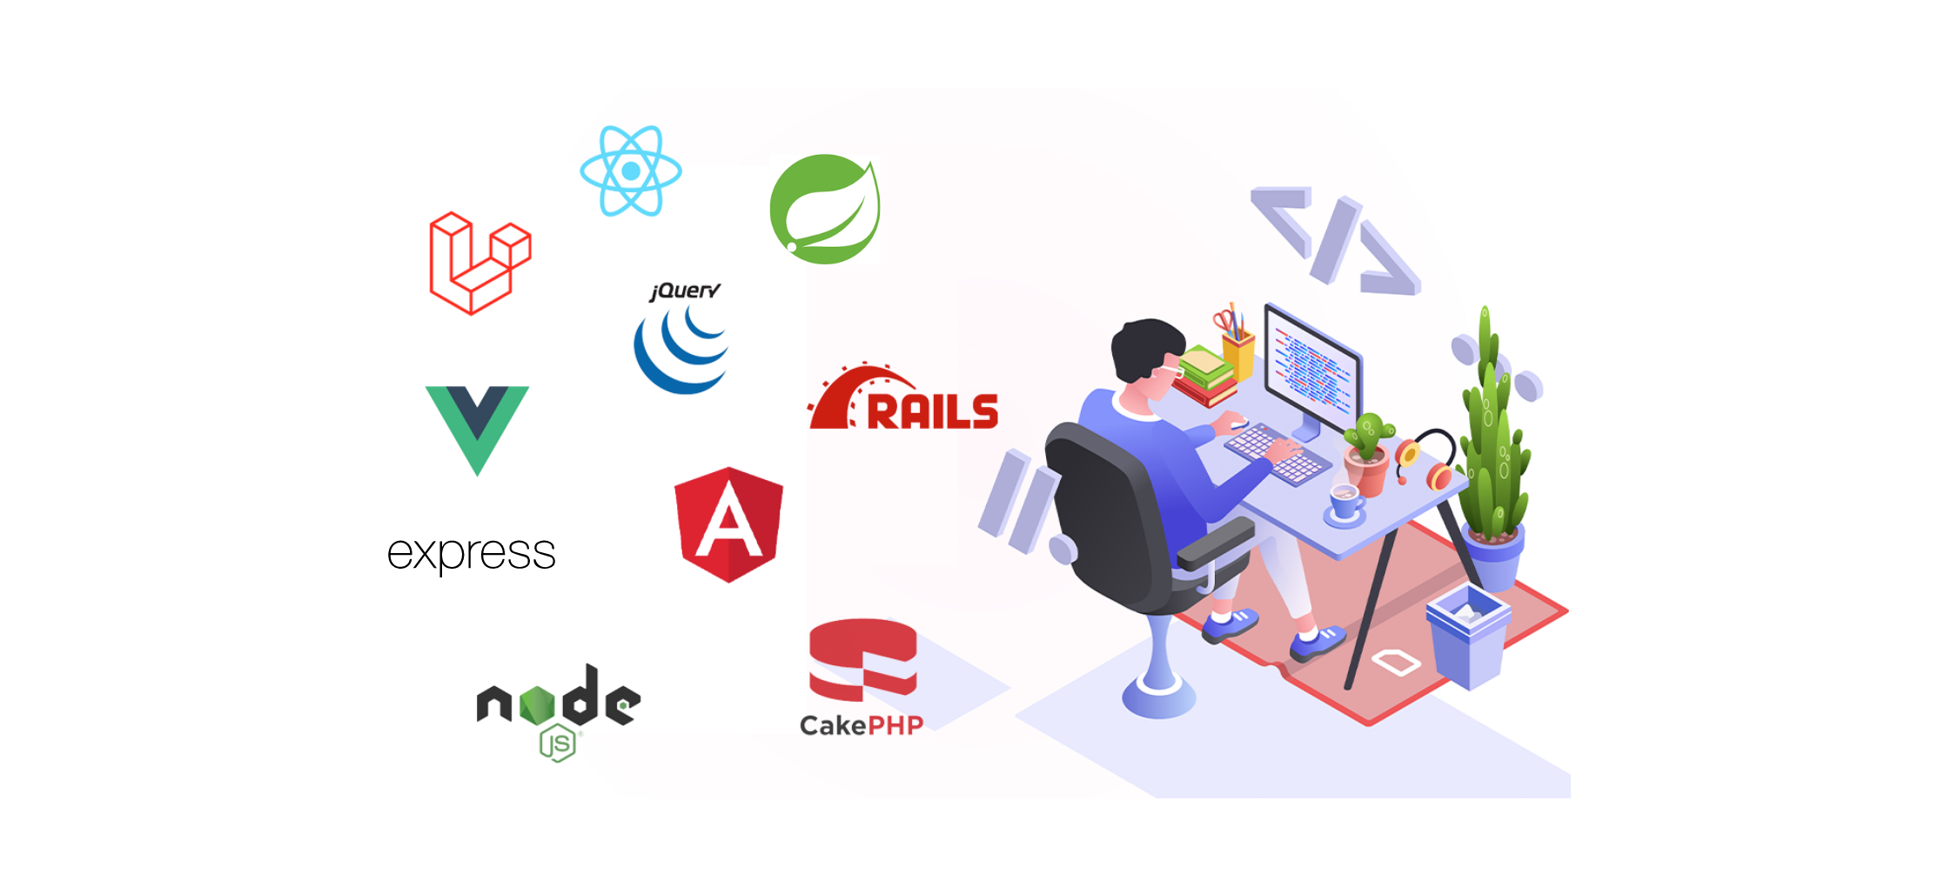
Programming Languages and Frameworks
Pick the programming languages and frameworks relevant to your project.
Frameworks like React, Spring, Angular, Vue.js, Ruby on Rails, Django, or Laravel may be needed based on your project's requirements.

Slide 27
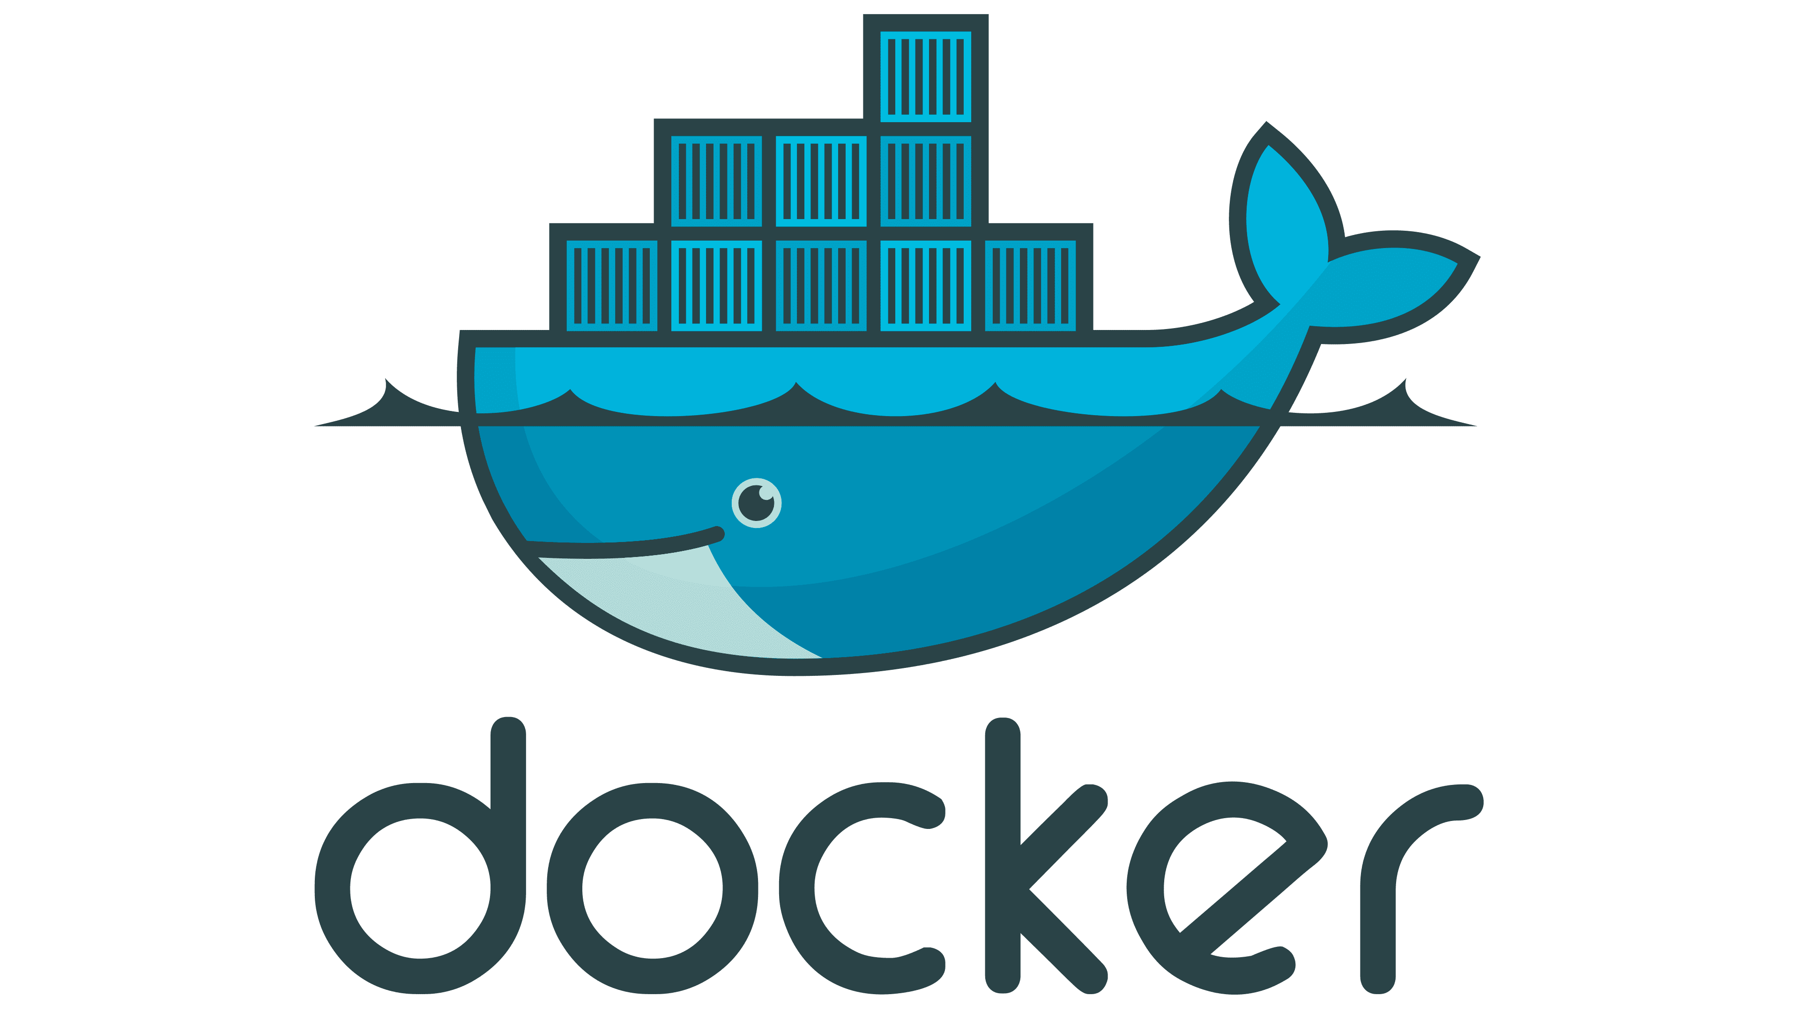
Local Development Environment
Consider using virtualization or containerization technologies like Docker to set up consistent development environments that match your production environment.

Slide 28
Testing Environments
Set up testing environments, including staging and QA environments, to test your web application thoroughly before deployment.
Integration Testing Environment - Integration testing involves testing the interactions between different components or modules of a software system. These components are brought together and tested in the integration testing environment to ensure they work together correctly.
Staging Environment - The staging environment replicates the production environment where final testing and quality assurance are performed before a software release. It mirrors the production environment's configuration as closely as possible.
Virtual Testing Environment - Virtualization technologies, such as virtual machines (VMs) and containers, create isolated testing environments that can be easily replicated for various testing purposes.

Slide 29

Activity 2
Consider the scenario where your team will be responsible for developing a new e-commerce website.
Please describe the steps you would take, from initial planning to deployment, to ensure the successful development and launch of this e-commerce website.

